Slide 1
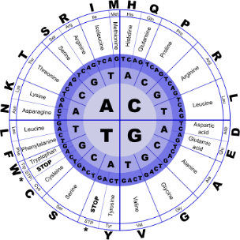
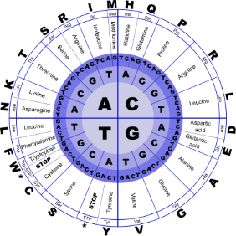


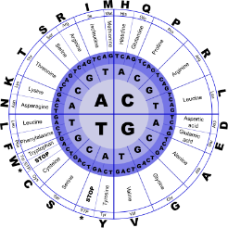
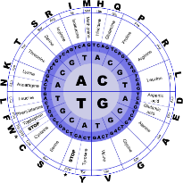
Fundamentals of Programming II
Polymorphism

Slide 2
Type Compatibility in Inheritance Hierarchies
Classes in a program
may be part of an
inheritance hierarchy
Classes lower in the
hierarchy are special
cases of those above
Animal
Cat
Dog
Poodle

Slide 3
Type Compatibility in Inheritance
A pointer to a derived class can be assigned to a pointer to a base class. Another way to say this is:
A base class pointer can point to derived class objects
Animal *pA = new Cat;

Slide 4
Polymorphism
Animal
Consider the Animal, Cat, Dog hierarchy where each class has its own version of the member function id( )
Cat
Dog
Poodle

Slide 5
Polymorphism
class Animal{
public: void id(){cout << "animal";}
}
class Cat : public Animal{
public: void id(){cout << "cat";}
}
class Dog : public Animal{
public: void id(){cout << "dog";}
}

Slide 6
Polymorphism
Consider the collection of different Animal objects
Animal *pA[] = {new Animal, new Dog,
new Cat};
and accompanying code
for(int k=0; k<3; k++)
pA[k]->id();
Prints: animal animal animal, ignoring the more specific versions of id() in Dog and Cat

Slide 7
Composition vs. Inheritance
When defining a new class:
Composition is appropriate when the new class needs to use an object of an existing class
Inheritance is appropriate when
objects of the new class are a subset of the objects of the existing class, or
objects of the new class will be used in the same ways as the objects of the existing class

